Slide 1

Global Economic Trends: Analyzing GDP Growth Across Countries
Group 9
Abhiram Kattunga
Sai Surya Teja Medisetty
Sai Sampadaa Gomatham
Jayanth Kodamanchili

Slide 2

Introduction to the Visualization
In this project, we developed an interactive dashboard to analyze and visualize global GDP trends across over 200 countries from 1960 to 2020. Our main objective was to create a platform where users can easily explore economic indicators like GDP Growth (%), GDP per Capita Growth (%), and GDP per Capita (USD) using dynamic visualizations.
The task involved answering three key questions:
What? — We aimed to present historical economic growth patterns across different countries and regions, making complex data accessible and understandable through visual storytelling.
Why? — Understanding GDP trends is critical for analyzing a nation's economic health, comparing global growth patterns, and predicting future economic outcomes.
How? — We built the dashboard using HTML, CSS, and JavaScript, leveraging libraries such as D3.js for the choropleth map and Chart.js for line, bar, scatter, and pie charts. The dashboard allows users to select countries, adjust the timeline, switch visualization types, view comparative insights, explore GDP tables, and even predict the next year's GDP values.
Through this project, we combined data processing, web development, and interactive design to create a meaningful visualization tool that supports economic analysis in an engaging and user-friendly way.

Slide 3
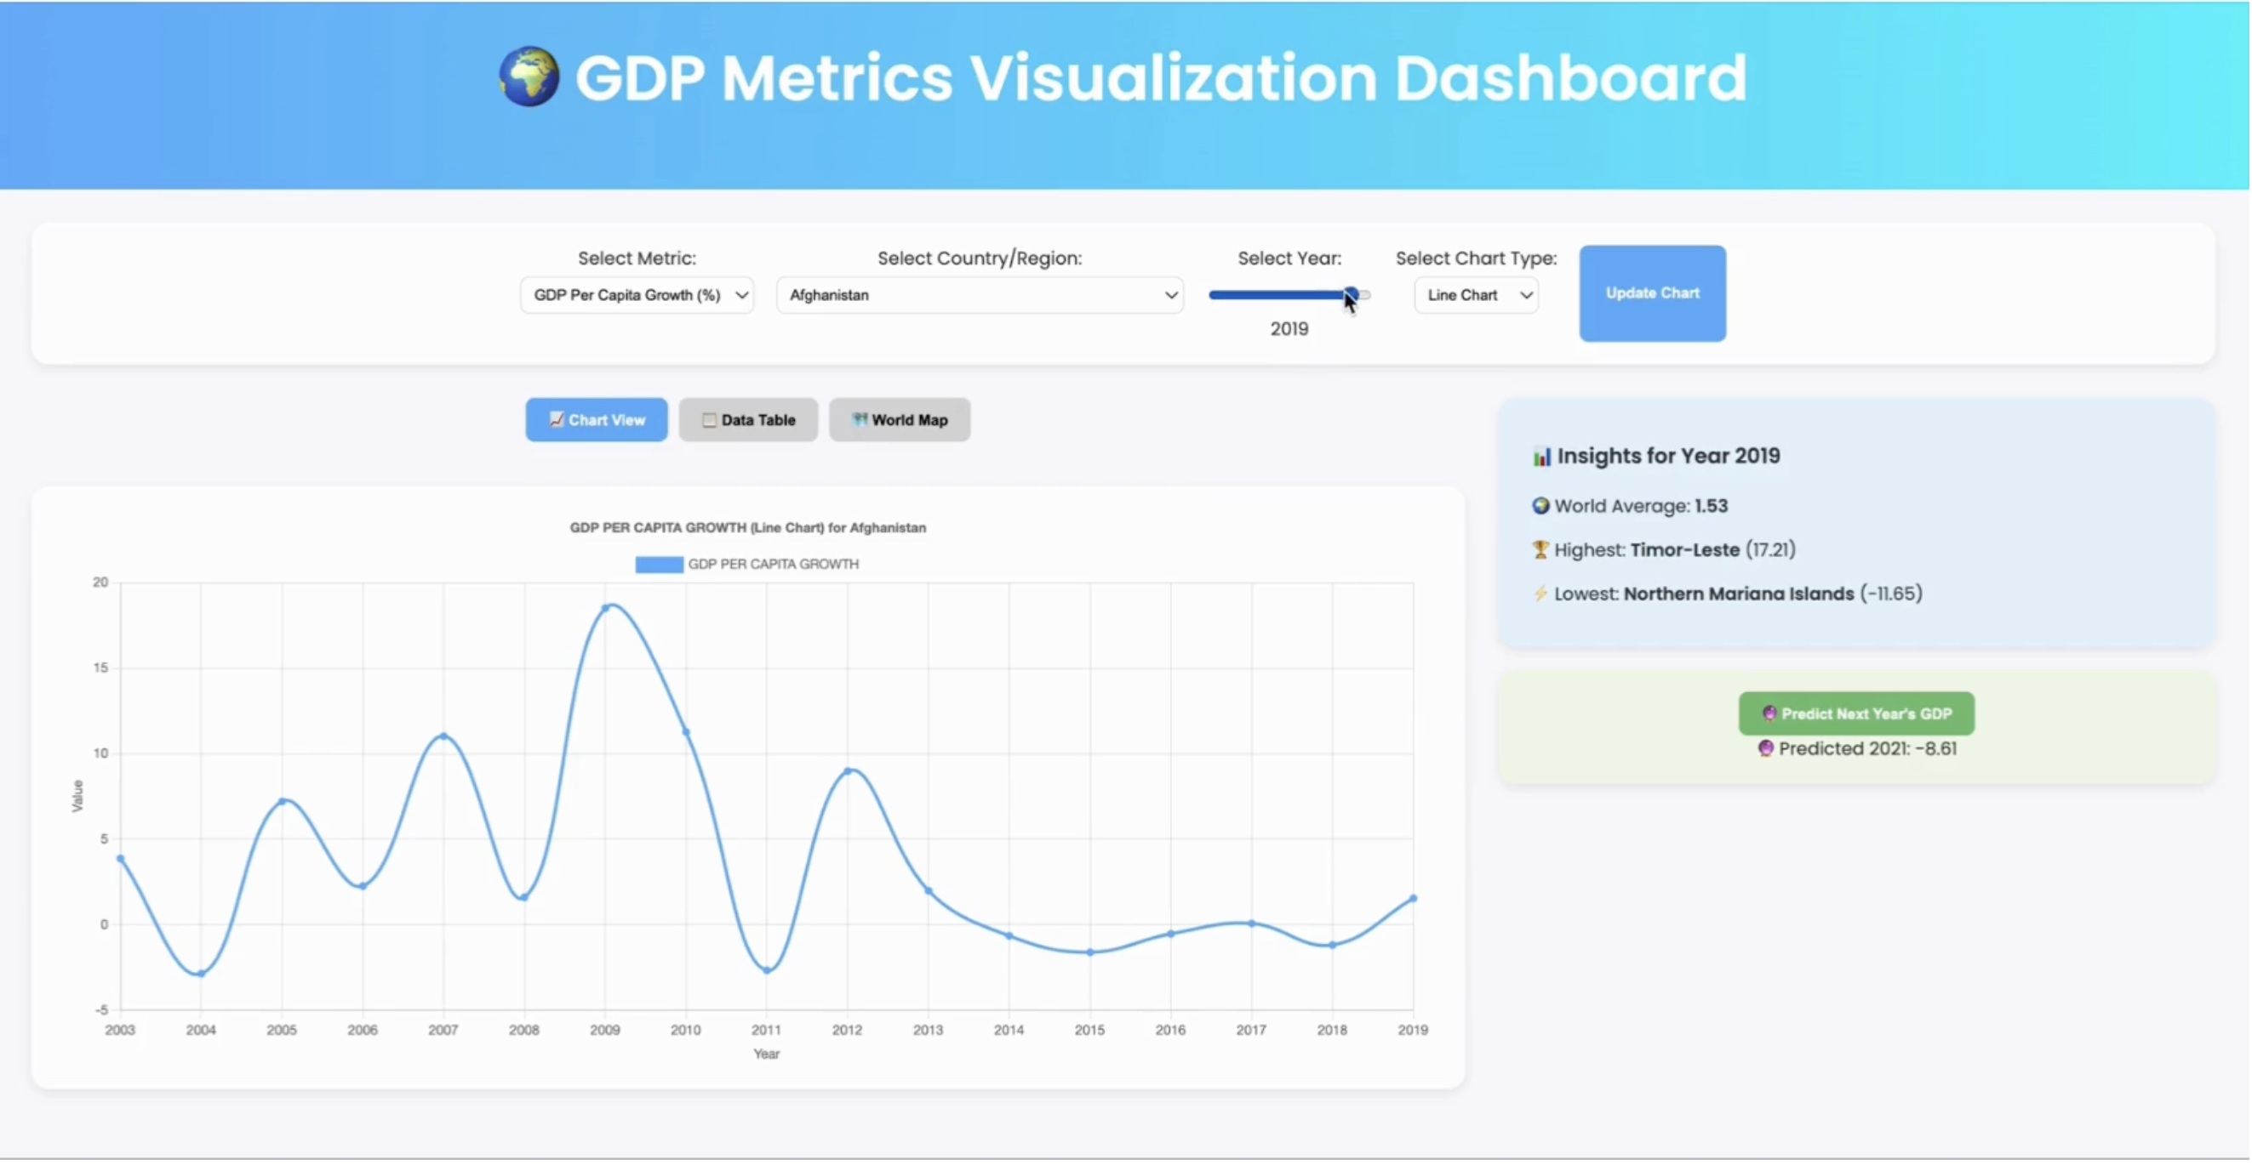
Dashboard Demo

Slide 4
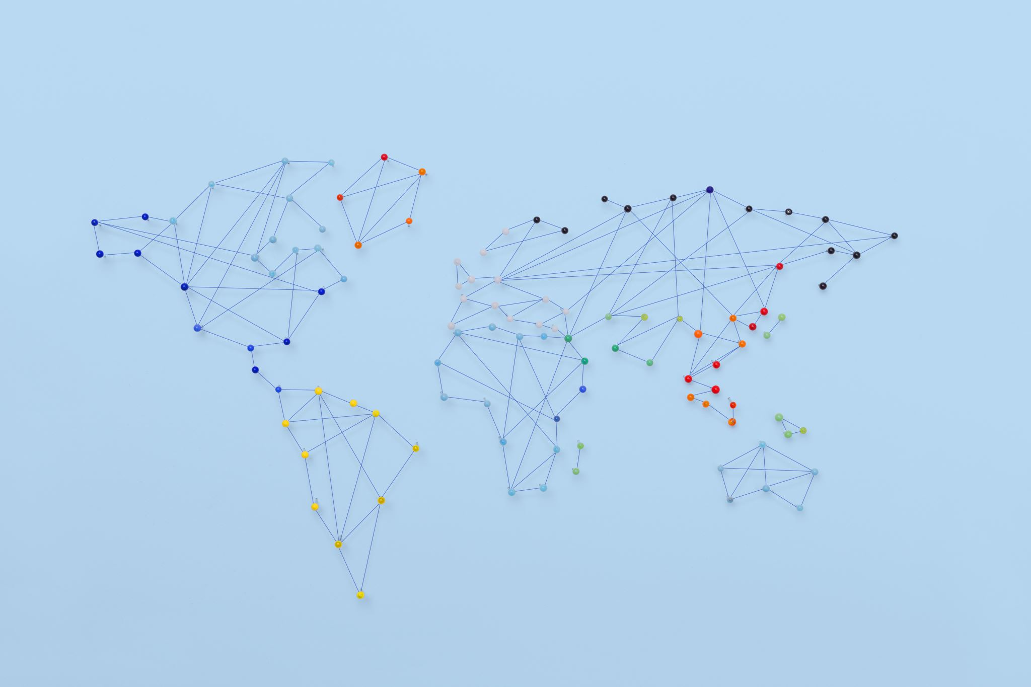
Conclusion and Improvements
Conclusion
We successfully developed an interactive dashboard that visualizes 60 years of global GDP trends across 200+ countries. By combining dynamic charts, a world choropleth map, data tables, and prediction tools, we made economic insights simple, engaging, and accessible for users. The platform emphasizes clarity, interactivity, and real-time exploration of historical economic patterns.
Possible Improvements
Add more indicators like Inflation and Unemployment for deeper analysis.
Implement machine learning models for more accurate GDP forecasting.
Integrate real-time data APIs for automatic updates.
Enhance mobile optimization and accessibility features.

